Slide 1
PROCEDURES
GROUP 4 PRESENTATION

Slide 2
Group Members
Solomon Kiptoo 101293
Megan Mueni 101681
Ibrahim Aziz 101020
Hezekiel Gachu 100384
Walter Nyangaga 97730

Slide 3
Topic Objectives
o To know how input-output works in assembly language.
o To learn about the runtime stack, the fundamental mechanism for calling and returning from subroutines.
o To divide large programs into modular subroutines.
o To learn about flowcharts, which are graphing tools that portray program logic.

Slide 4
What are procedures ?
A procedure is a set of code that can be branched to and returned from in such a way that the code appears as if it were inserted at a point from which it is branched to.
Branch to procedure - call
Branch back procedure - return

Slide 5
Procedure declaration
This is the syntax of procedure declaration:
PROC name type
; body of procedure
ret
ENDP name
type can be NEAR (in same segment) or FAR (in a different segment) -- if omitted, NEAR is assumed

Slide 6
LINKING TO AN EXTERNAL LIBRARY

Slide 7
Definition of a Link Library
o A link library - A file containing procedures that have been compiled into machine code. It can be constructed from one or more object files (.obj)

Slide 8
For Instance:
o Suppose a program displays a string in the console window by calling a procedure name WriteString.
 The program source must contain a PROTO directive identifying the WriteString procedure: WriteString PROTO
 Next, a CALL instruction executes WriteString: call WriteString

Slide 9
o When the program is assembled, the assembler leaves the target address of the CALL instruction blank, knowing that it will be filled in by the linker.
o The linker looks for WriteString in the link library and copies the appropriate machine instructions from the library into the program’s executables file. In addition, it inserts WriteString’s address into the CALL instruction

Slide 10
Linking to a Library
Using Linker Command Options
The linker utility combines a program’s object file with one or more object files and link libraries.
The following command, for example, links hello.obj to the irvine32.lib and kernel32.lib libraries:
link hello.obj irvine32.lib kernel32.lib

Slide 11
Linking to a Library ...continued
2) Linking 32-Bit Programs
o kernel32.lib: Part of the MS-Windows Platform Software Developments Kit (SDK). It contains linking information for system functions located in a file named kernel32.dll.
o kernel32.dll: MS-Windows Dynamic Link Library (DLL). It contains executable functions that perform character-based input-output.
o irvin32.lib: A collection of helpful functions. It also provides library functions that read and print integers.

Slide 12
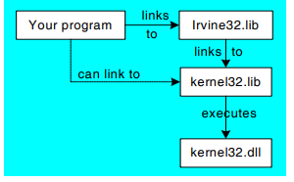
Fig 1.1: How kernel32.lib is a bridge to kernel32.dll:

Slide 13
The Book’s Link Library

Slide 14
Overview
Makes it easier for us to process input-output in assembly language application.
There are plenty of library procedures, which implement different system functions.
Examples:
•Clrscr: clears console, locates cursor at upper left corner.
•CloseFile: closes an open disk file.
•StrLength: returns length of a string

Slide 15
contd.
•WaitMsg: displays message, waits for enter key to be pressed.
•Randomize: Seeds the random number generator.
•Crlf: moves cursor to the next line on screen
•Etc.

Slide 16
Example Test Programs
Displaying an unsigned integer:
x = 40
.code
mov eax, x
call WriteBin ;display number in binary
call Crlf ;Takes cursor to the next line
call WriteDec ; displays in decimal
call Crlf
call WriteHex ;displays in hexadecimal
call Crlf

Slide 17
Changing screen settings:
main PROC
mov eax, yellow + (blue * 16)
call SetTextColor
call Clrscr

Slide 18
Generating and displaying 10 random integers between 0-99
Main PROC
mov ecx,10 ; loop counter
L1: mov eax,100; ceiling value
call RandomRange ; generate random int
call WriteInt ; display signed int
call Crlf ; goto next display line
loop L1 ; repeat loop

Slide 19
Stack Operations 129

Slide 20
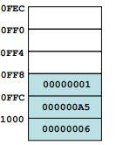
STACKS
Data Structure with a Last In First Out Structure
Data is added from the top and removed only from the Top

Slide 21
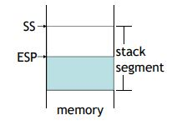
Runtime Stacks
Managed in the CPU by
Stack Segment (SS) - points to the base of the Current Segment being addressed.
Stack Pointer (ESP) - stores the address of the last program request in a stack.

Slide 22
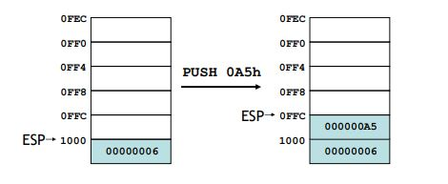
Push Operation
Syntax:
Push Register(or Memory)
Example: PUSH EAX
In push operation, the ESP Decrements by 2(16 bit operands) or 4(32 bit)
Then Copies Values to the new location pointed to

Slide 23
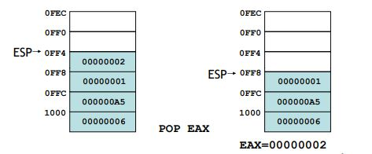
Pop Operation
Syntax:
POP REGISTER (or Memory)
POP EAX
Data at the location Pointed by the ESP is copied, Then a value n (2 for 16 bit operands, 4 for 32 bit operands) is added to the ESP

Slide 24
When To Use Stacks
To save Temporary Data
To pass Arguments
Local Variables
Storing the Return address for CALL

Slide 25
Defining and Using Procedures

Slide 26
PROC Directive
The proc directive is used in the definition of procedures
The directive identifies a portion of code as being a procedure
General format of a procedure is
ADD PROC
‘
‘
Ret
ADD ENDP
At the end of the procedure we use ENDP to close the procedure code.

Slide 27
Example of a summation procedure
mov ecx,'4'
sub ecx, '0'
mov edx, '5'
sub edx, '0'
sumOf PROC
mov eax, ecx
add eax, edx
add eax, '0'
ret
SumOF ENDP

Slide 28
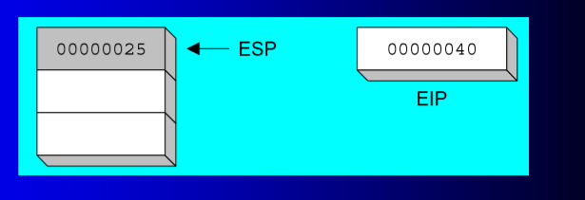
The Call and Ret Instructions
CALL
The call instruction is used to push a certain named procedure onto the stack to be executed.
It then copies the address of the referenced procedure onto the EIP register.

Slide 29
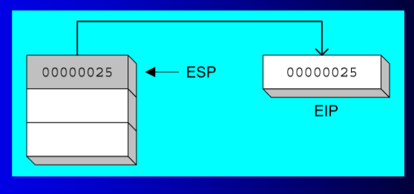
The RET Instruction
This instruction indicates the end of procedure operations.
It pops the procedure from the stack and allows the system to continue with normal running

Slide 30
Nested Procedure calls
Procedures can be defined in such a way that they call one another,
Nested procedure format:
Main PROC
;
call add
exit
main ENDP
add PROC
:
Ret
Add ENDP

Slide 31
Saving and restoring Registers.
o When both the calling program and procedure share the same set of registers, it is necessary to save the registers when entering a procedure, and restore them before returning to the calling program.
o These are done by the pus and pop directives, the push directive saves the data that was in a specific register before it enters the procedure.
o Once the procedure operation has been completed, the pop instruction restores the values that were in the register.

Slide 32
ArraySum PROC
push esi ; save ESI, ECX
push ecx
mov eax,0 ; set the sum to zero
L1: add eax,[esi] ; add each integer to sum
add esi,TYPE DWORD ; point to next integer
loop L1 ; repeat for array size
pop ecx ; restore ESI, ECX
pop esi
Ret ; sum is in EAX
ArraySum ENDP

Slide 33
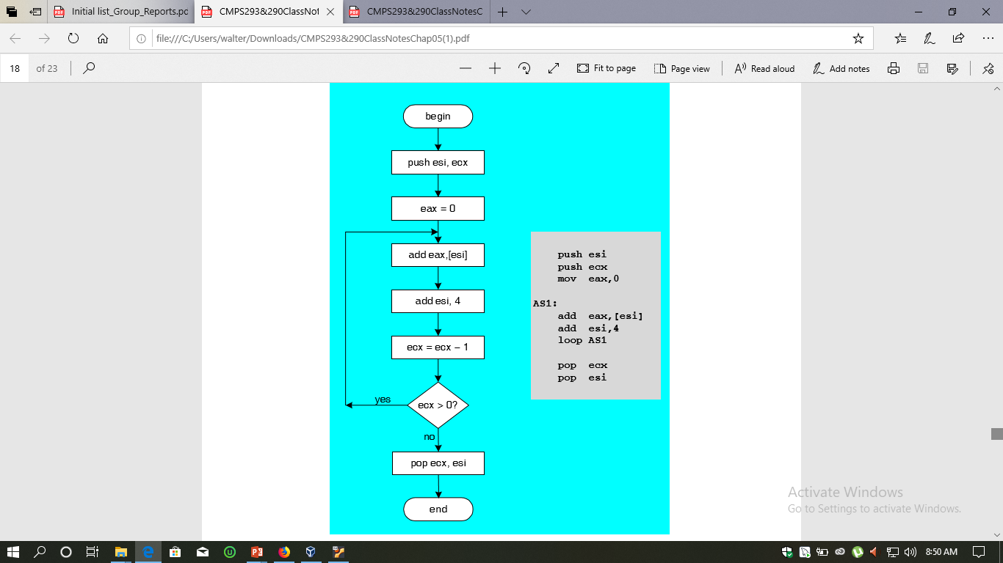
Flow Charts
Diagrammatic Representation

Slide 34
Program Design Using Procedures

Slide 35
Integer summation Program
The ADD instruction is used for performing simple addition of binary data in byte (8-bit), word (16-bit) and doubleword (32-bit).
The ADD instruction have the following syntax
ADD destination, source
The ADD instruction can take place between −
Register to register - add eax, ebx
Register to constant data - add eax, ‘0’

Slide 36
example:
mov ecx,'4'
sub ecx, '0'
mov edx, '5'
sub edx, '0'
sumOf PROC
mov eax, ecx
add eax, edx
add eax, '0'
ret
SumOF ENDP

Slide 37
REFERENCES
Patel J, S., & Patt, Y. (2004). Introduction to Computing Systems: From Bits and Gates to C and Beyond (2nd ed.). McGraw-Hill.
Kip R. Irvine. (2007). Assembly Language for Intel-Based Computers (Fifth Edition) Prentice Hall Publishing, Inc.

